Slide 1
Truth in Dark Web Advertising
Robert W. Gehl
www.robertwgehl.org
robert@robertwgehl.org

Slide 2

Influencers

Slide 3
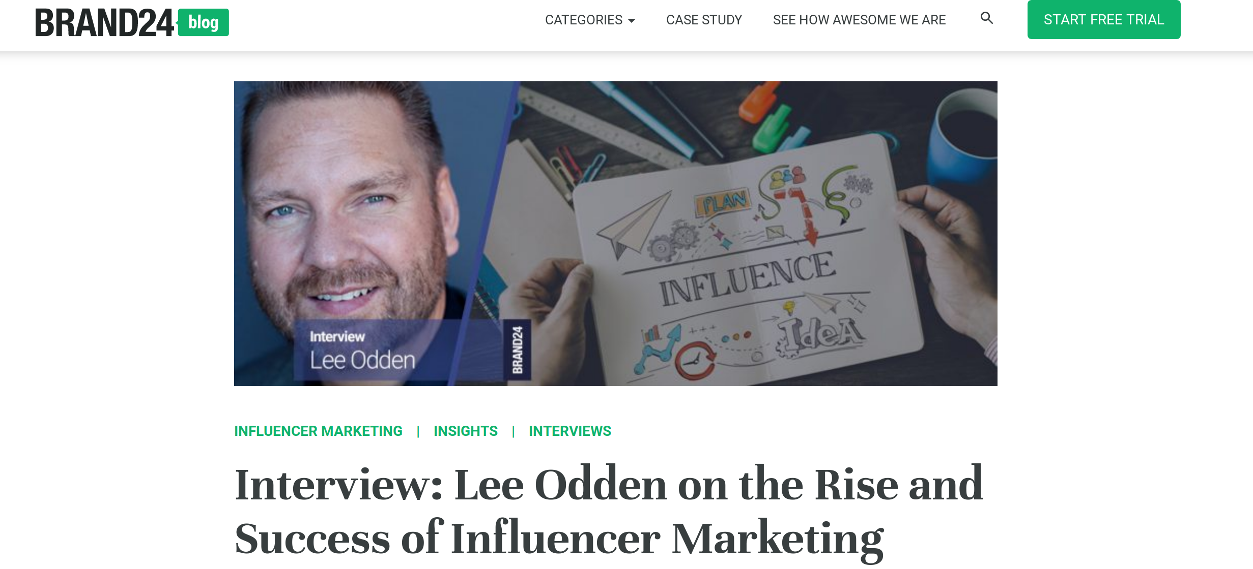
Influencers

Slide 4
Influencers
“today’s buyers are overloaded with information and generally don’t trust brand advertising or content. They do trust peers and influencers though...”

Slide 5
Influencers
“today’s buyers are overloaded with information and generally don’t trust brand advertising or content. They do trust peers and influencers though...”
“Everyone is empowered to publish content, attract an audience and become influential.”

Slide 6

Influencers

Slide 7

Influencers

Slide 8
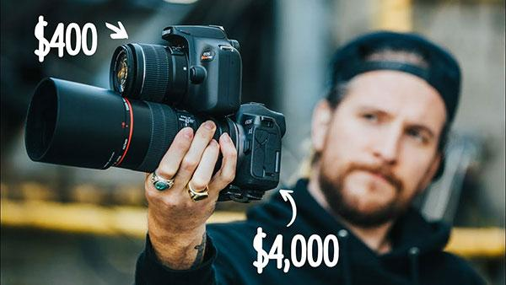
Influencers

Slide 9
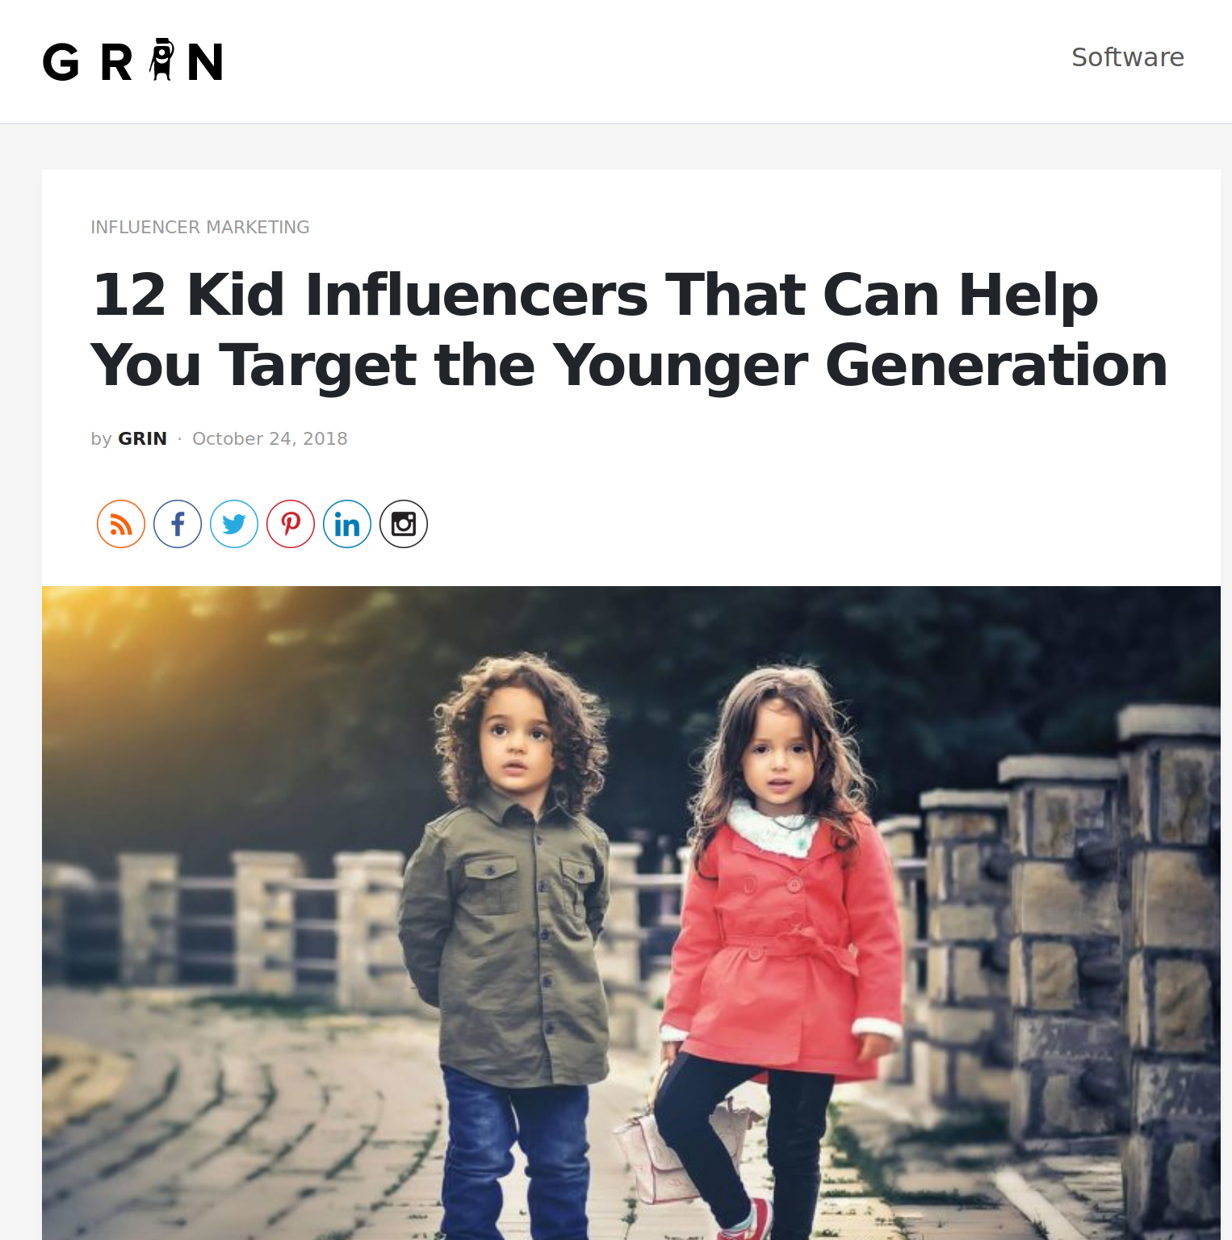
Influencers

Slide 10
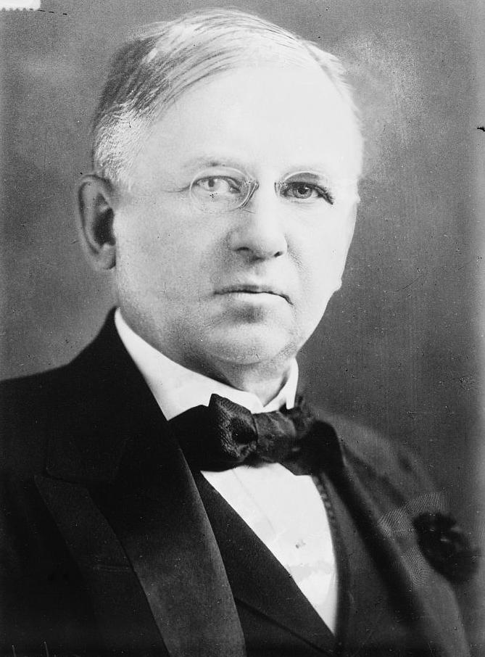
john Wanamaker

Slide 11
john Wanamaker
“I know half the money I spend on advertising is wasted; I just don’t know which half.”

Slide 12

jeff Hammerbacher

Slide 13
jeff Hammerbacher
“The best minds of my generation are thinking about how to make people click ads. That sucks.”

Slide 14

Digital Corporate Surveillance

Slide 15
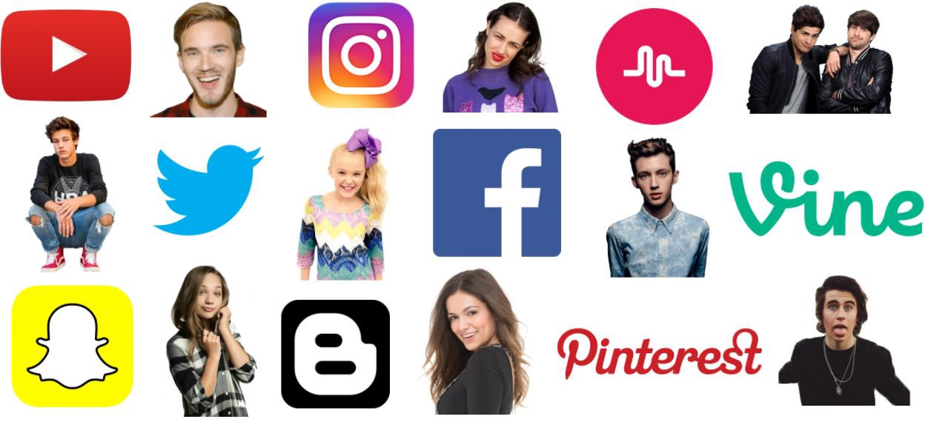
Digital Corporate Surveillance

Slide 16

Digital Corporate Surveillance

Slide 17

Digital Corporate Surveillance

Slide 18
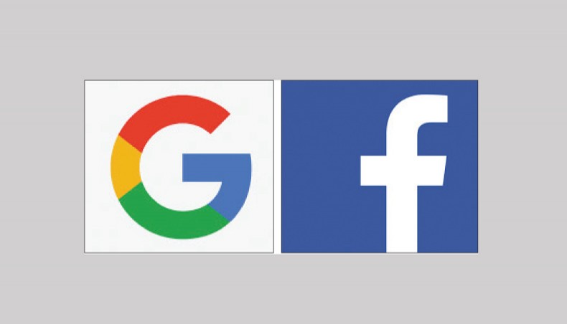
Digital Corporate Surveillance

Slide 19

Digital Corporate Surveillance

Slide 20
john Wanamaker’s lament
“I know half the money I spend on advertising is wasted; I just don’t know which half.”

Slide 21
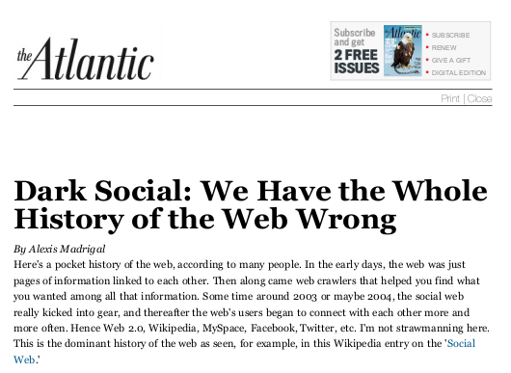
dark social

Slide 22
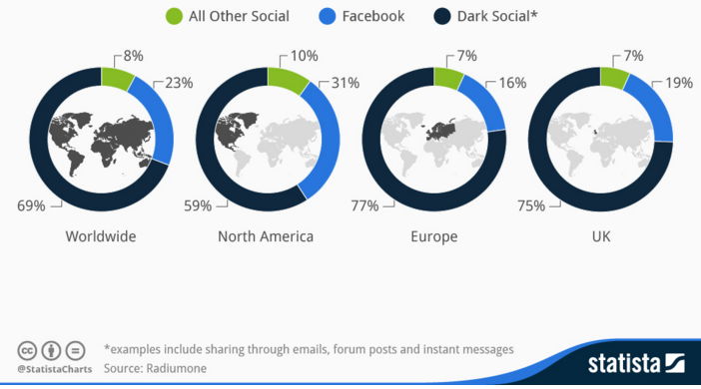
dark social

Slide 23
dark social

Slide 24
dark social

Slide 25
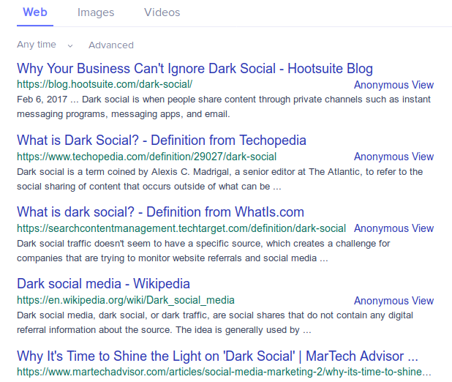
dark social

Slide 26
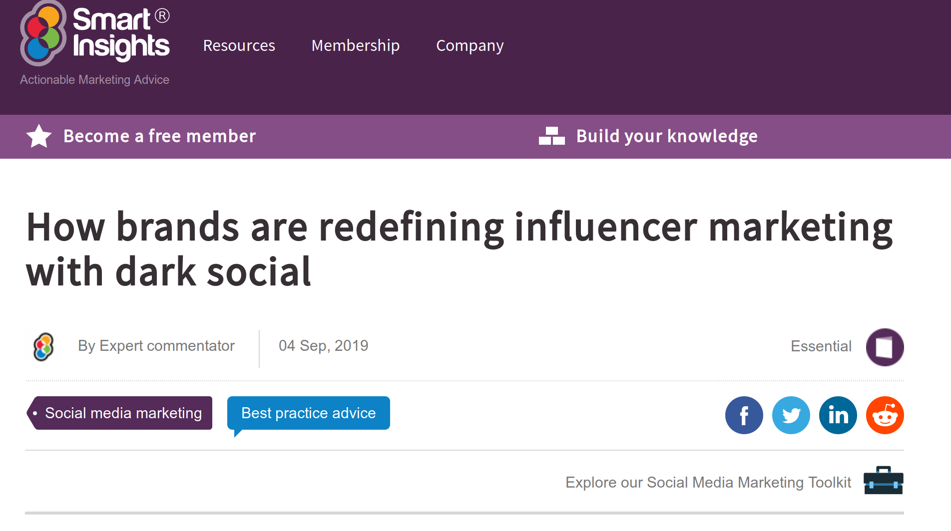
dark social

Slide 27
dark social
“This is where influencer marketing comes into play. Typically, influencers have loyal fan followings and are highly trusted. Their recommendations can influence purchase decisions as their followers seek their opinions.”

Slide 28
dark social
“If an influencer sends a link to a product page through private messaging, it’s likely that it will get a lot of clicks. That’s how influencer marketing can seamlessly merge with dark social.”

Slide 29



“dark social” and “Dark web”

Slide 30
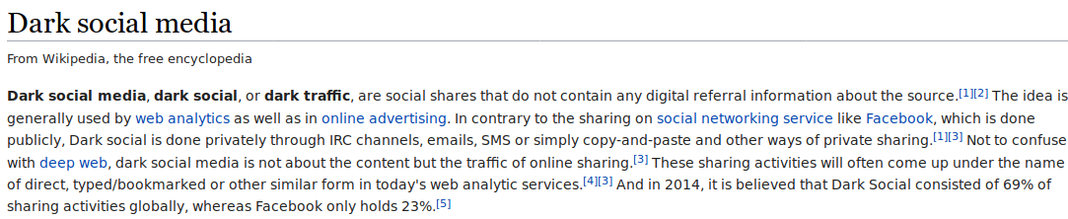
“dark social” and “Dark web”

Slide 31
“dark social” and “Dark web”
“Dark social” akin to the the “which half?” lack of knowledge

Slide 32
“dark social” and “Dark web”
“Dark social” akin to the the “which half?” lack of knowledge
“Dark Web” is dark in the sense of “going dark” with communications on a reduced scale or out of the “clear”

Slide 33
Dark social Workshop
We need to “acknowledge the manner in which powerful institutional actors use these decentralized technologies to reinforce their authority and control.”

Slide 34
“dark social” and “Dark web”
Both dark social and dark web socializing are socialities that are beyond the ken of those in power.
And thus both are socialities that powerful actors seek to know (and thus command)

Slide 35
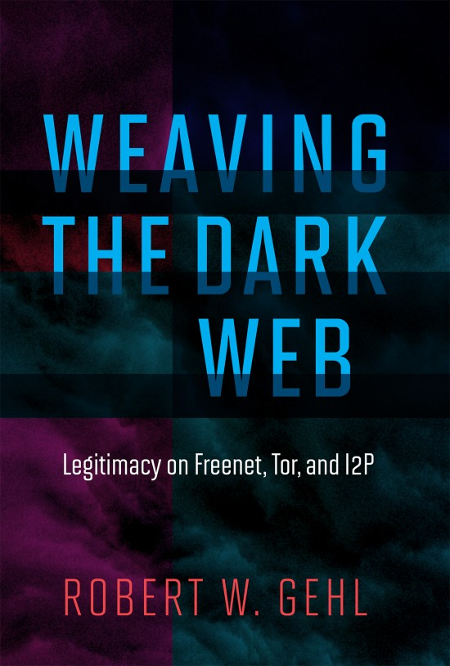
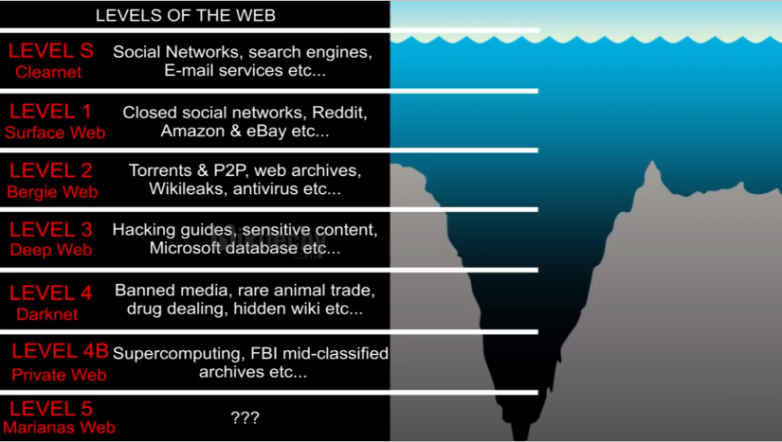
dark web research

Slide 36
“dark social” and “Dark web”
Given the ways in which the digital advertising industry has distorted “clearweb” sociality, is Dark Web advertising doing the same?

Slide 37
“dark social” and “Dark web”
Given the ways in which the digital advertising industry has distorted “clearweb” sociality, is Dark Web advertising doing the same?
What is the “will to know” of Dark Web advertising?

Slide 38
“dark social” and “Dark web”
Given the ways in which the digital advertising industry has distorted “clearweb” sociality, is Dark Web advertising doing the same?
What is the “will to know” of Dark Web advertising?
Are there any “best minds” looking to solve the tricky “which half” problem on the Dark Web?

Slide 39
“dark social” and “Dark web”
Given the ways in which the digital advertising industry has distorted “clearweb” sociality, is Dark Web advertising doing the same?
What is the “will to know” of Dark Web advertising?
Are there any “best minds” looking to solve the tricky “which half” problem on the Dark Web?
Can there ever be a Dark Web influencer?

Slide 40
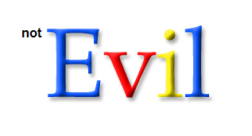
dark web search engines

Slide 41

dark web search engines

Slide 42
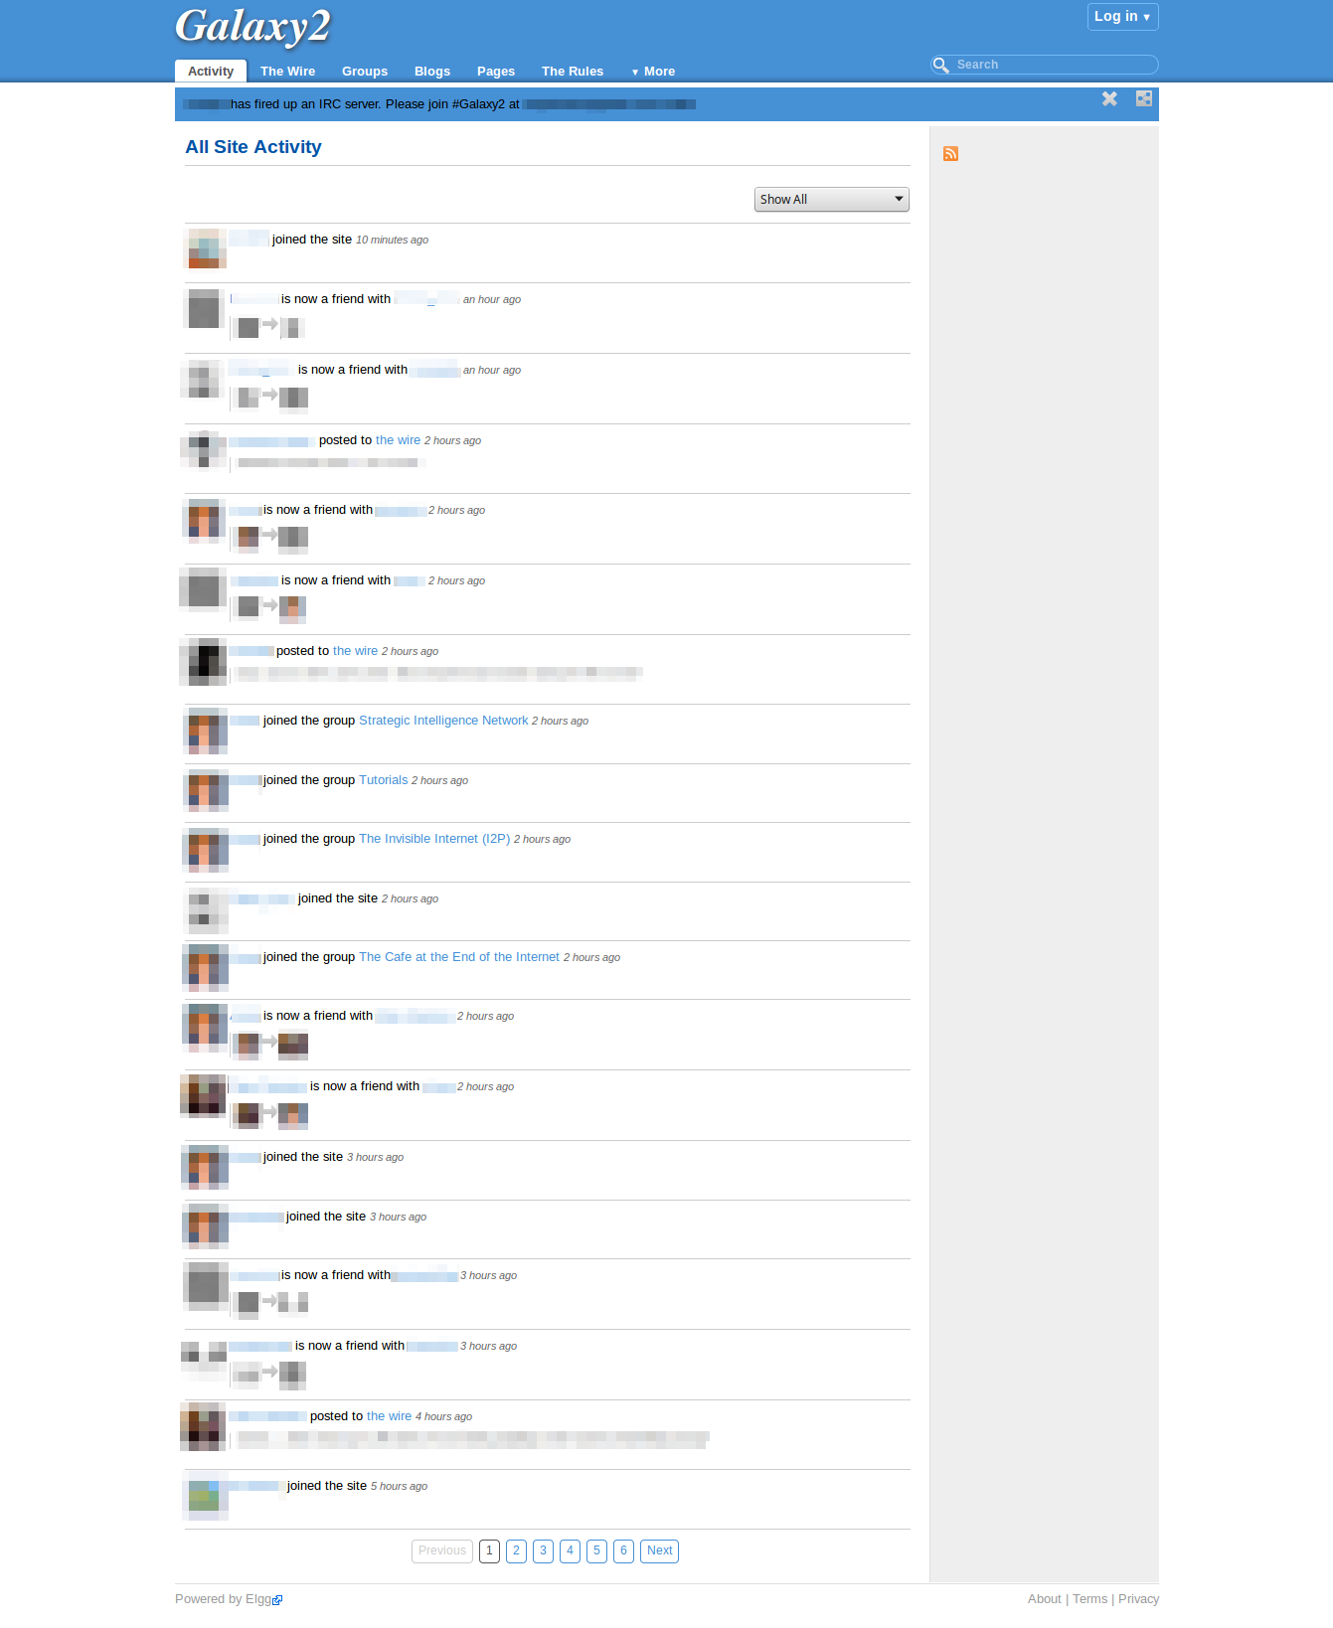
dark web social media

Slide 43
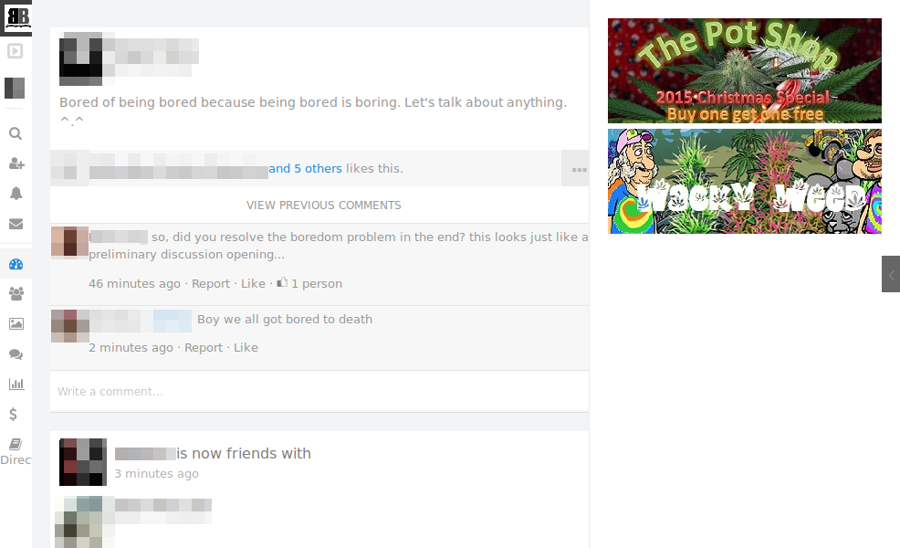
dark web social media

Slide 44
obligatory points of passage
Notes:
The brute fact of flows of money to the site operatorshas to be ocnsidered. Servers cost money. Hidden costs of moderation.

Slide 45

typical ads on the dark web
Ads for
  Bitcoin generators
  Drug markets
  Carding services
  Hitmen for hire
  “anti-scam” services

Slide 46
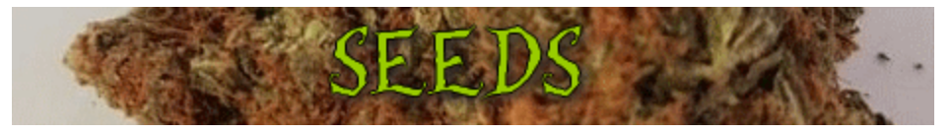
typical ads on the dark web

Slide 47
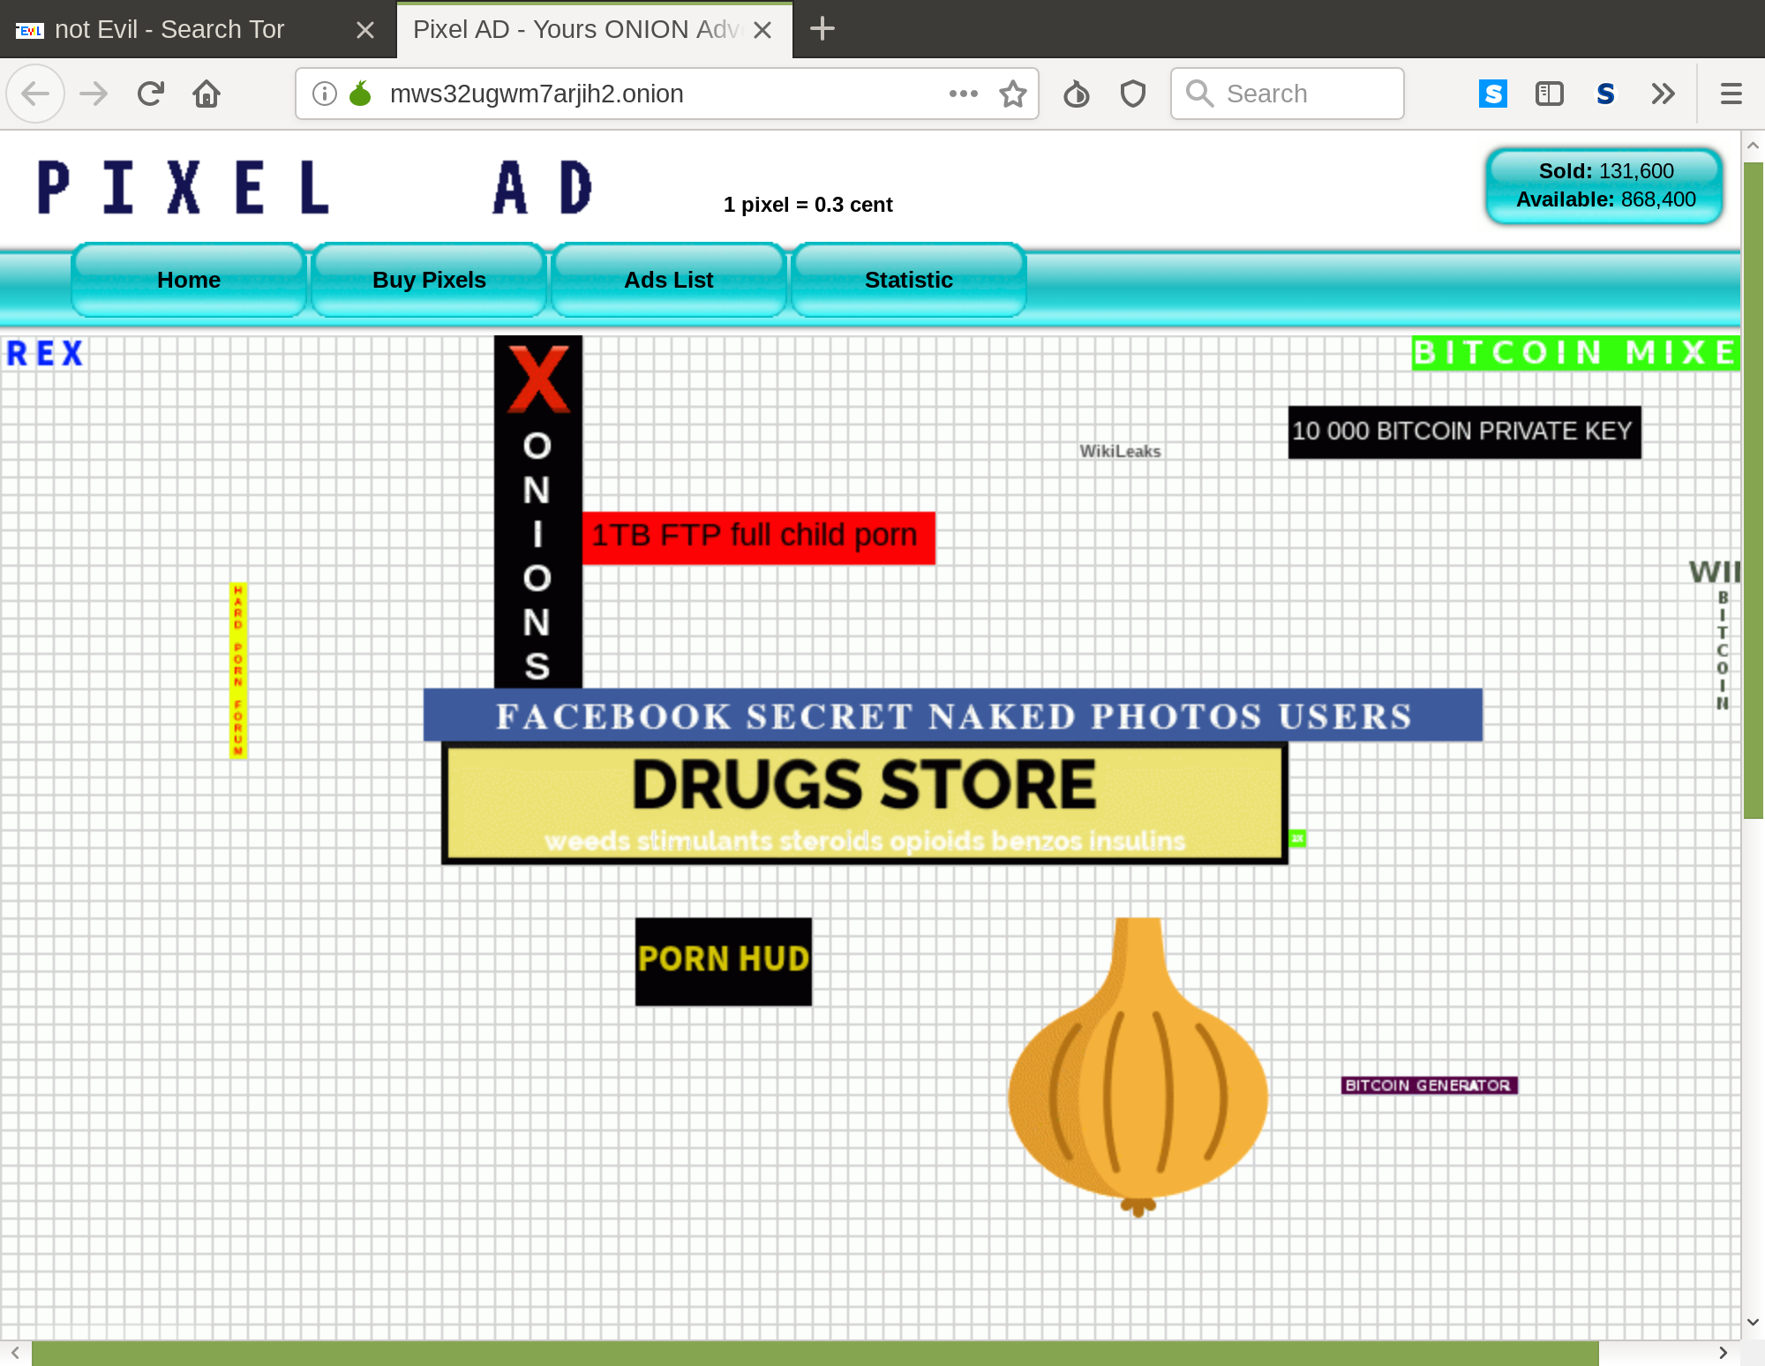
typical ads on the dark web

Slide 48

typical ads on the dark web

Slide 49

Banner exchanges and ad Networks

Slide 50
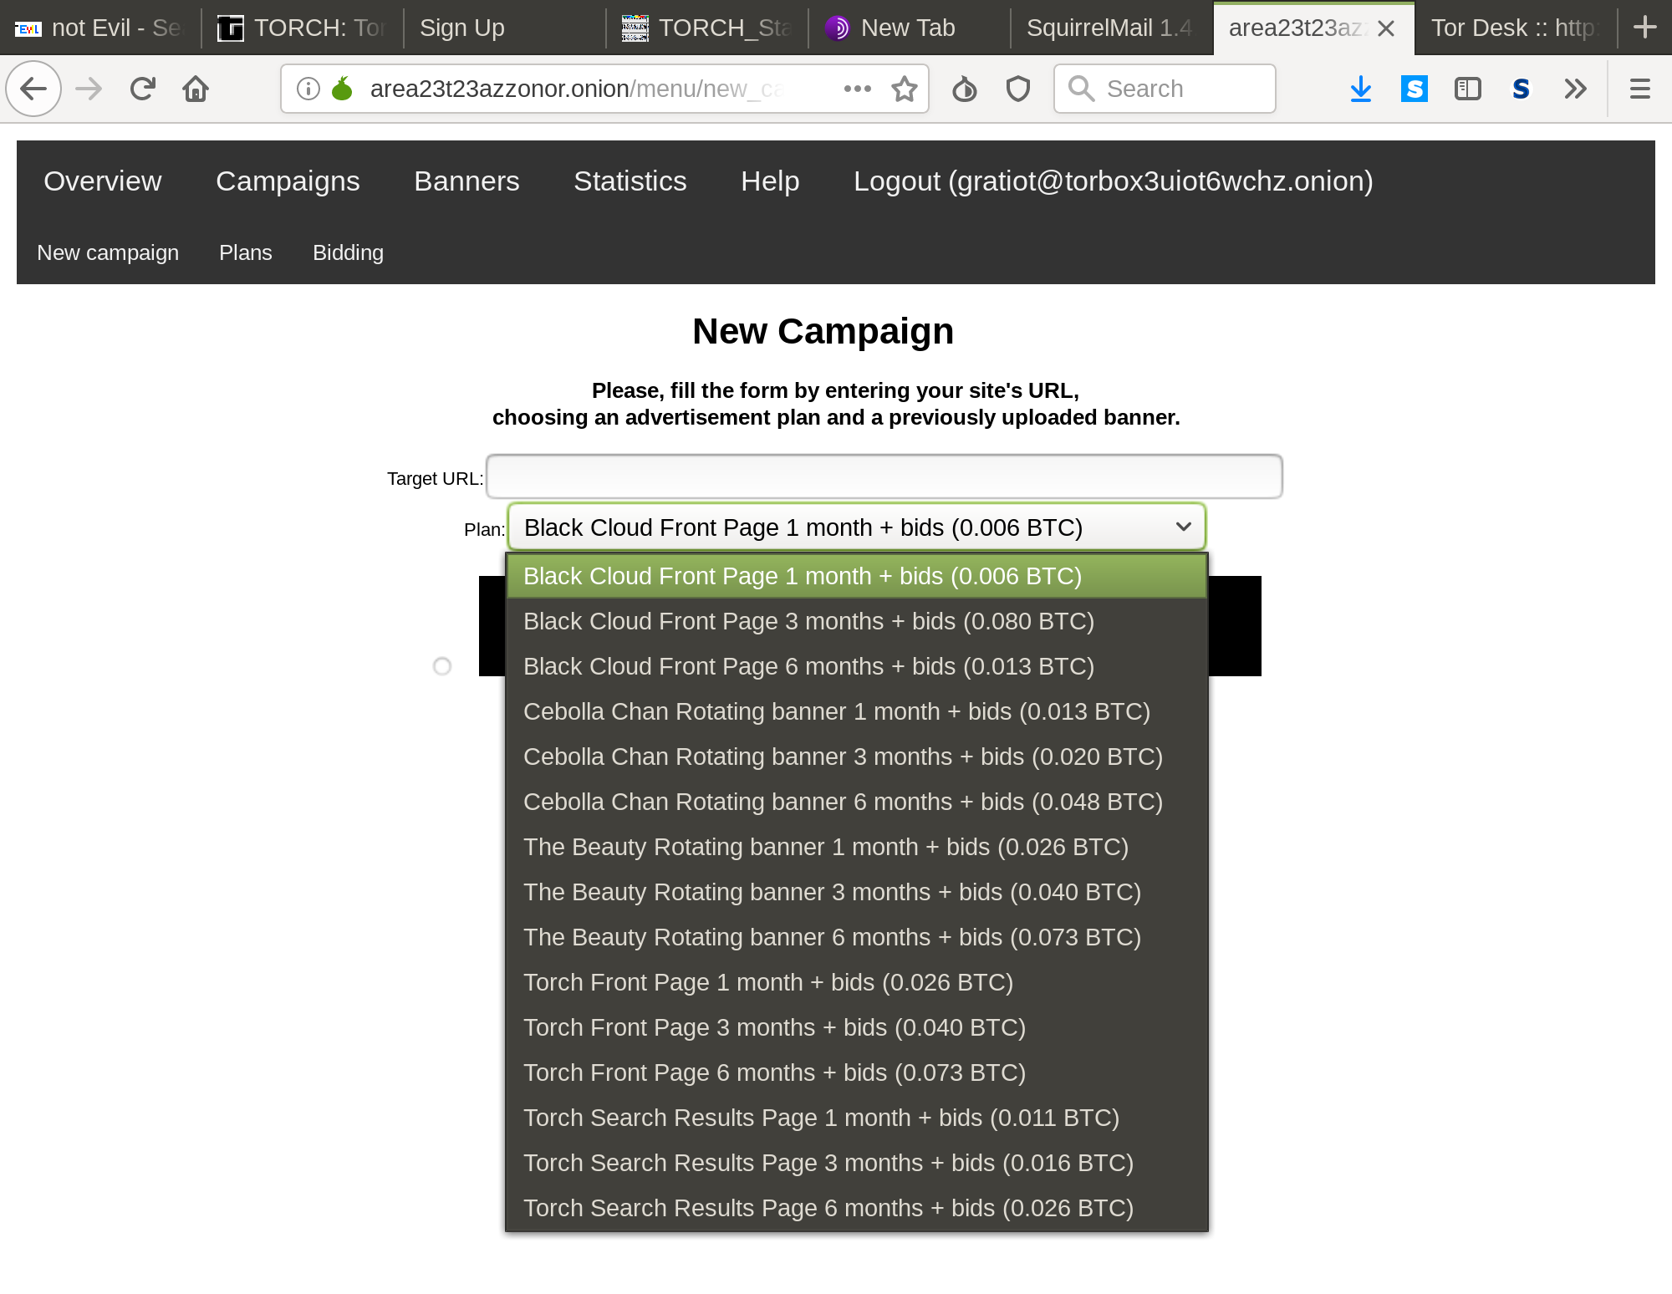
area23: more sophisticated

Slide 51

area23: more sophisticated

Slide 52
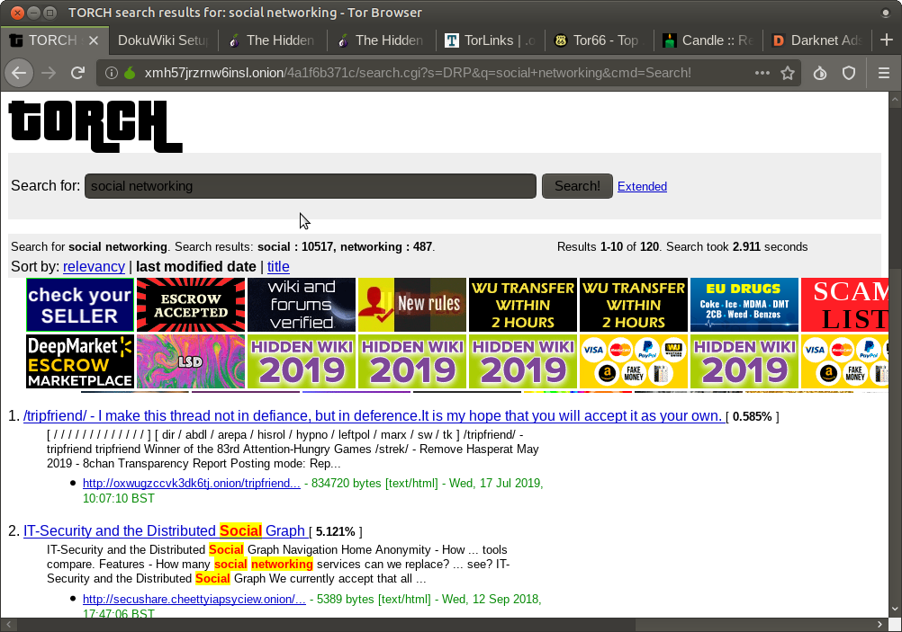
area23: more sophisticated

Slide 53
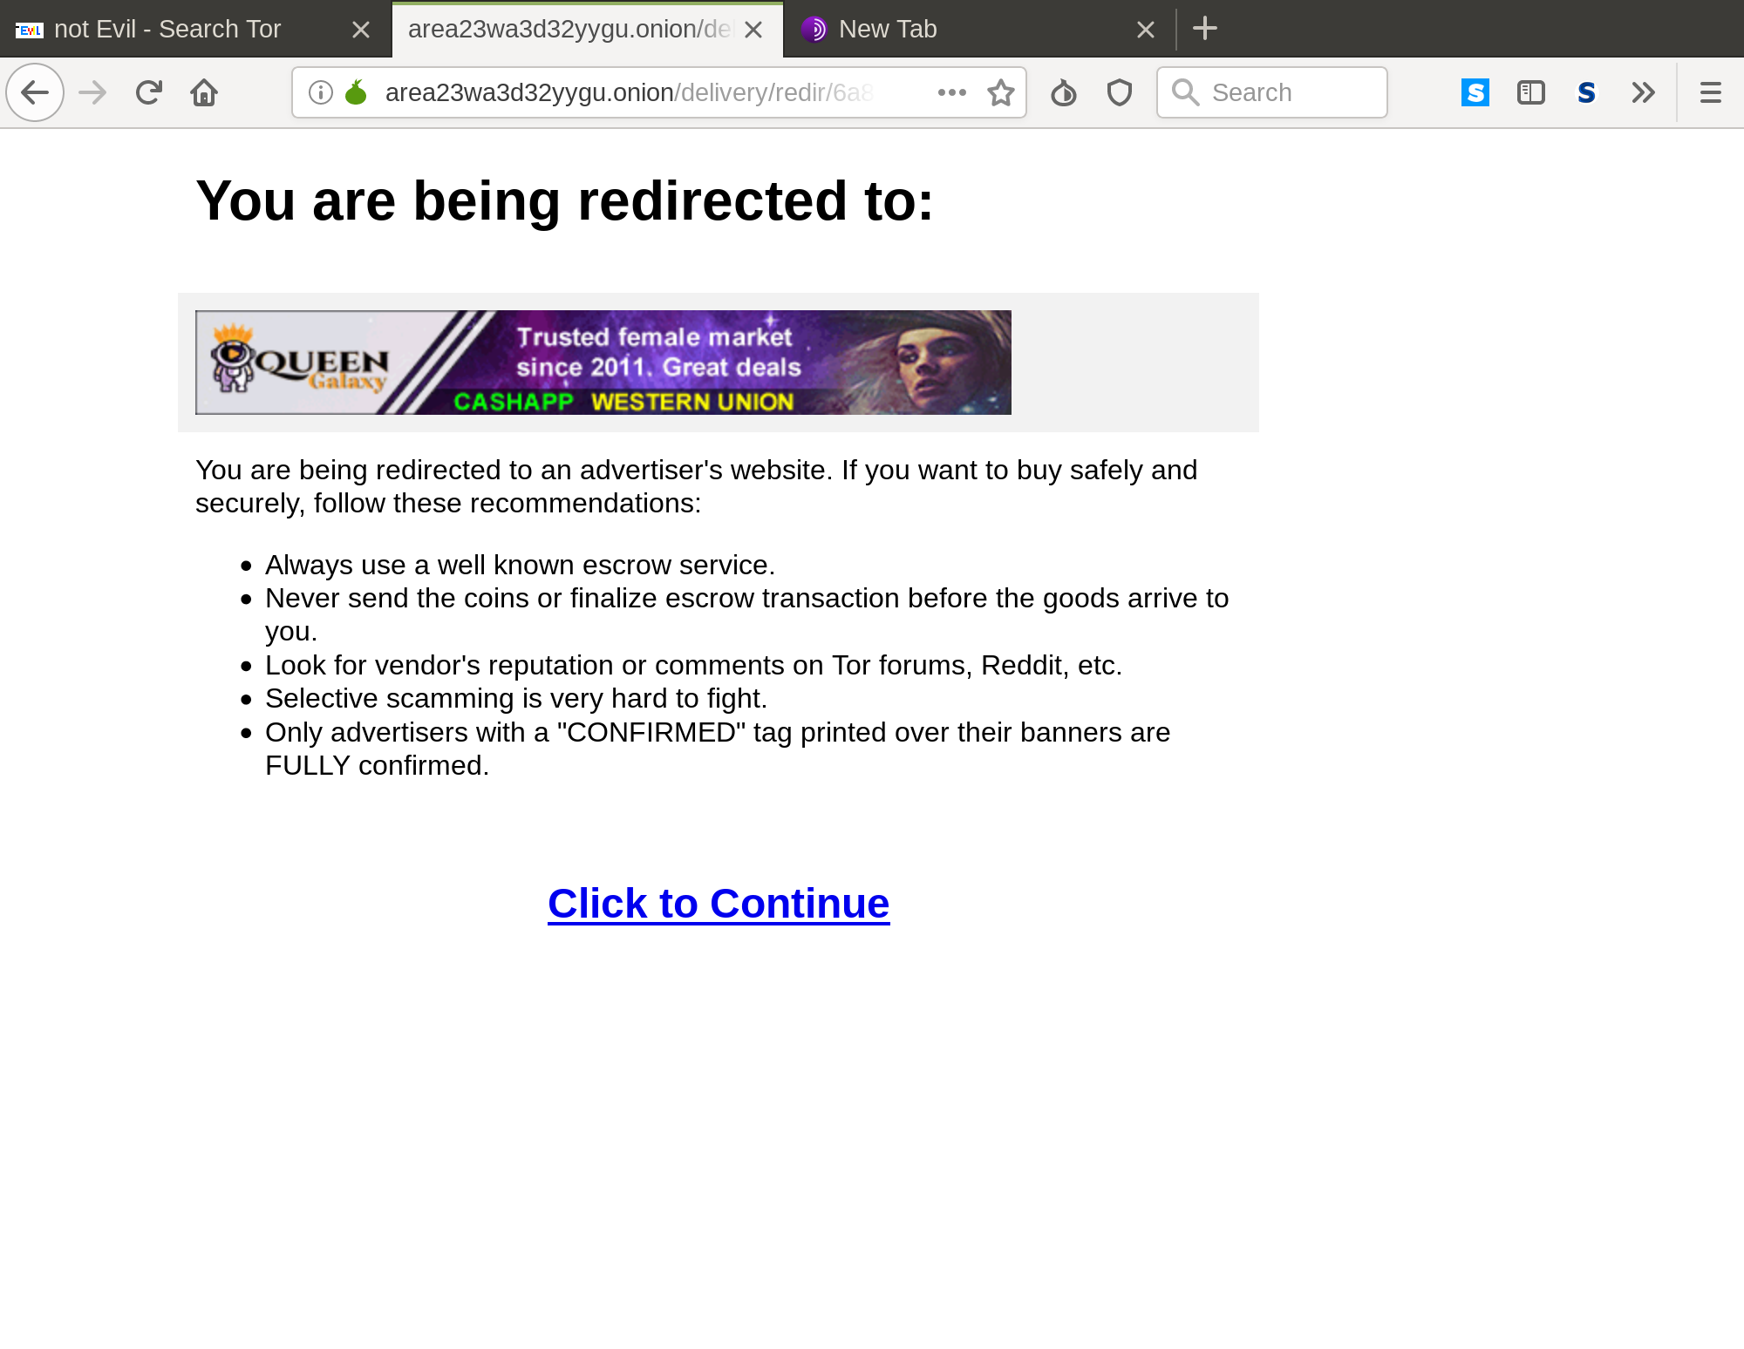
area23: more sophisticated

Slide 54
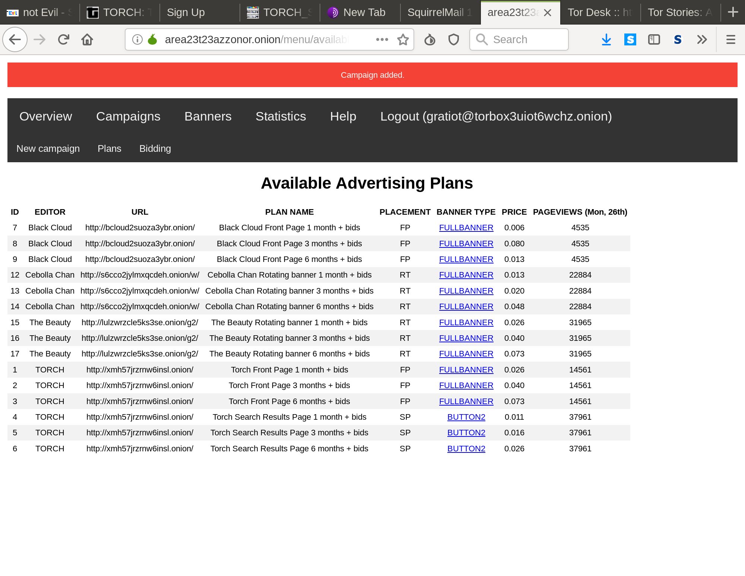
area23: more sophisticated

Slide 55
john Wanamaker on the dark web
“I know half the money I spend on advertising is wasted; I just don’t know which half.”

Slide 56

john Wanamaker on the dark web
“I know half the money I spend on advertising is wasted; I just don’t know which half.”

Slide 57
wanamaker on the dark web
In other words: are we closer to a moment when marketers and advertisers can spread their surveillance practices to the Dark Web?

Slide 58
wanamaker on the dark web
In other words: are we closer to a moment when marketers and advertisers can spread their surveillance practices to the Dark Web?
Will the best minds of our generation design ads for carding services?

Slide 59
wanamaker on the dark web
In other words: are we closer to a moment when marketers and advertisers can spread their surveillance practices to the Dark Web?
Will the best minds of our generation design ads for carding services?
Will there every be a Dark Web influencer?

Slide 60
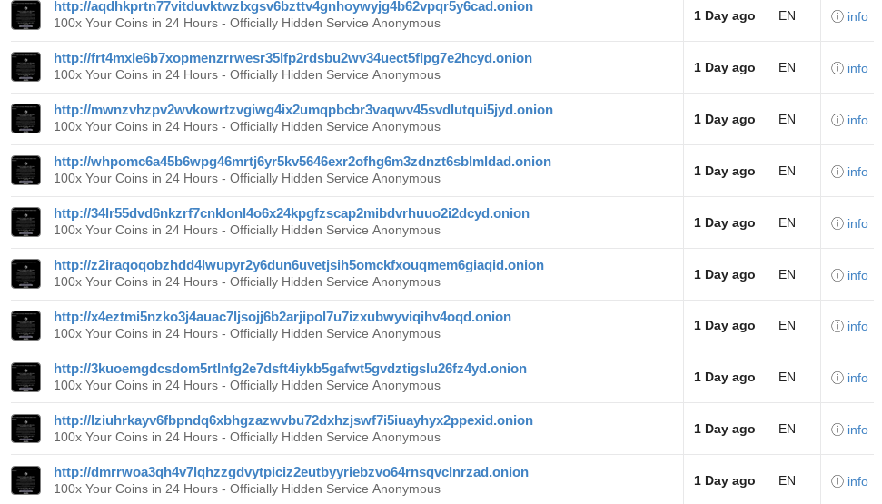
so many problems

Slide 61
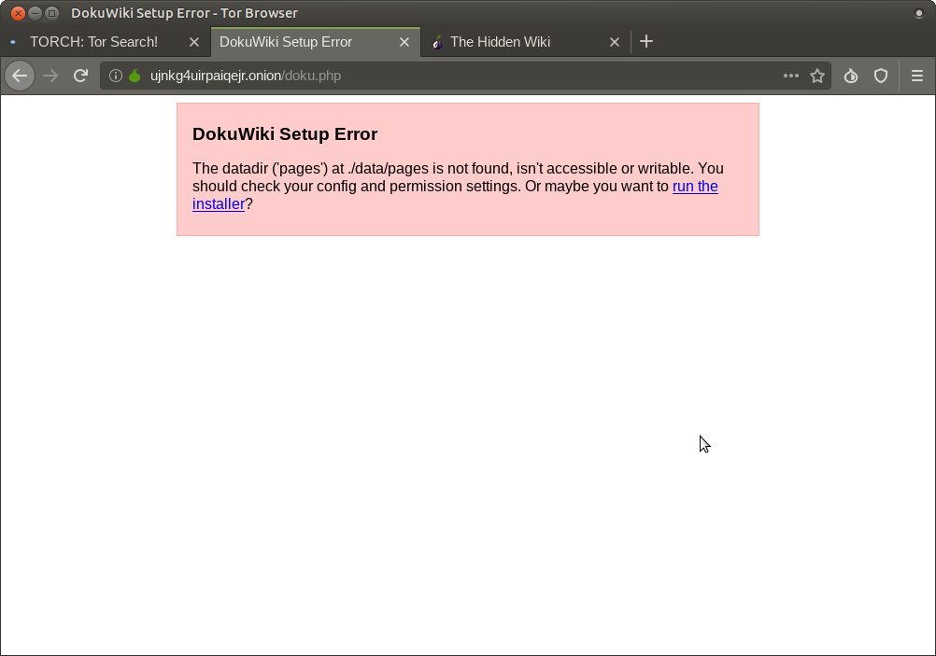

so many problems

Slide 62

so many problems

Slide 63
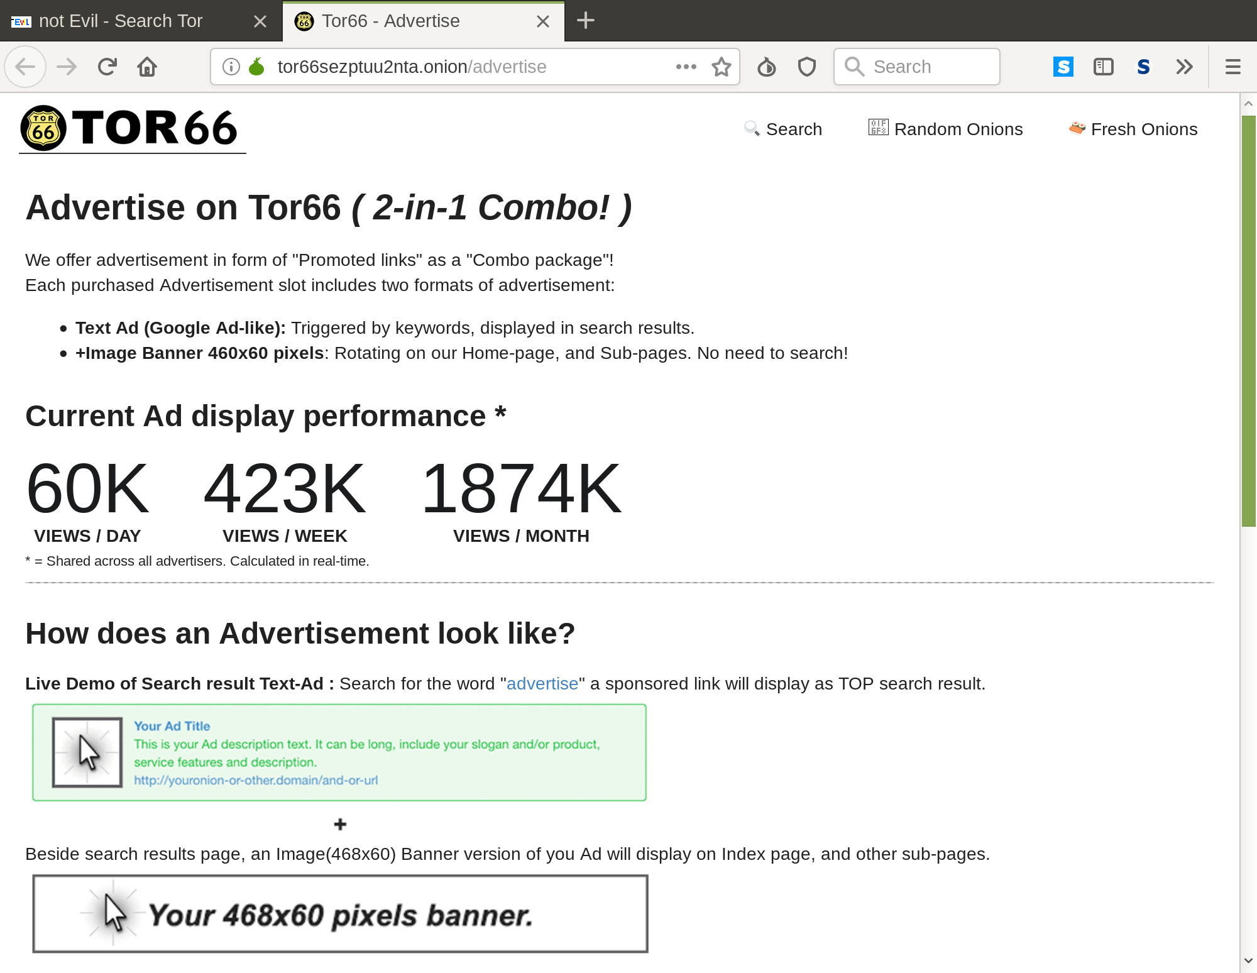
so many problems

Slide 64
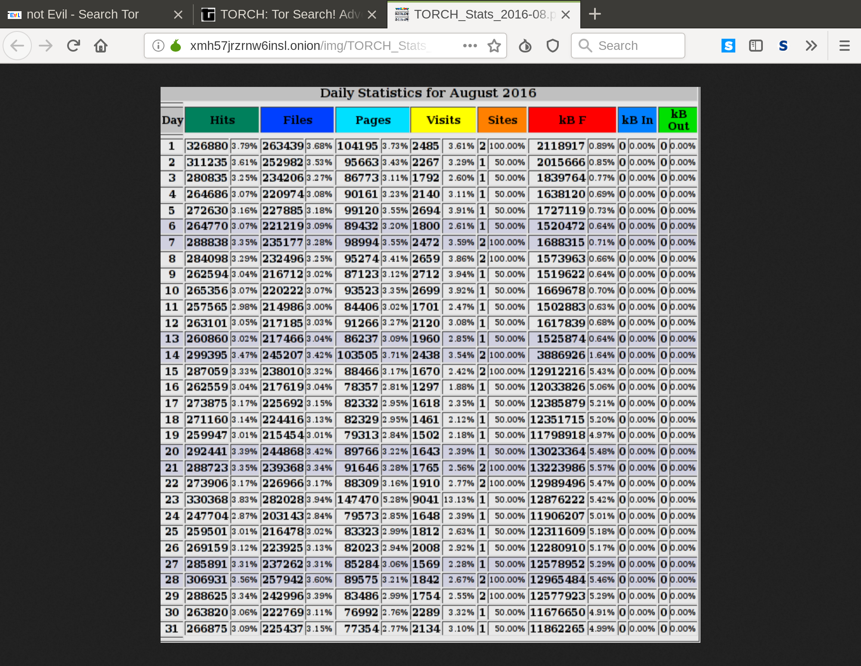
so many problems

Slide 65
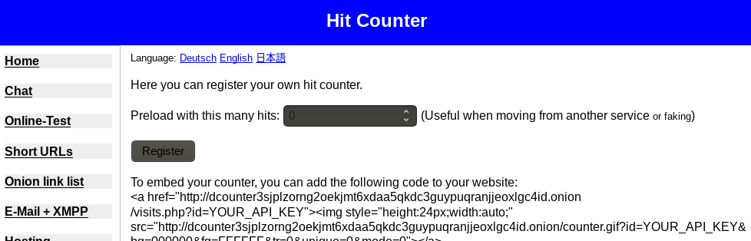
so many problems

Slide 66
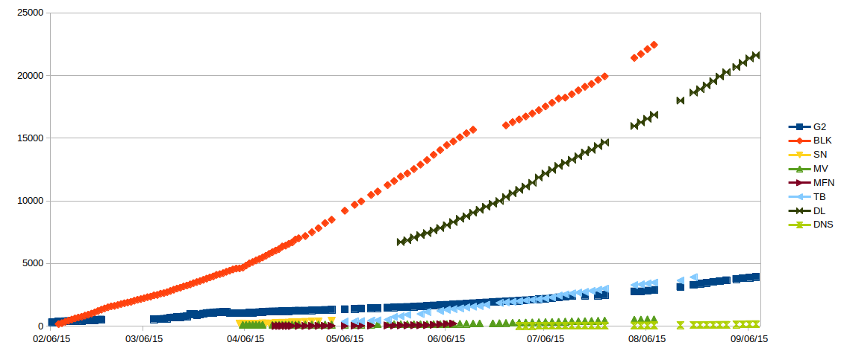
so many Problems

Slide 67
john Wanamaker on the dark web
“I know half the money I spend on advertising is wasted; I just don’t know which half.”

Slide 68
john Wanamaker on the dark web
“I know half the money I spend on advertising is wasted; I just don’t know which half.”
“In fact, I don’t know who I’m buying ad space from, whether it’s worth it, whether they will even post the ad, or even if someone else will simply copy my site in order to steal Bitcoins.”

Slide 69
what to make of Dark web advertising?
Four things:
  Dark Web advertising is an attempt to appropriate the legitimacy of Clear Web advertising

Slide 70
what to make of Dark web advertising?
Four things:
  Dark Web advertising is an attempt to appropriate the legitimacy of Clear Web advertising
  Dark Web advertising does influence clear web media practices

Slide 71
what to make of Dark web advertising?
Four things:
  Dark Web advertising is an attempt to appropriate the legitimacy of Clear Web advertising
  Dark Web advertising does influence clear web media practices
  Dark Web resistance to metrification undermines the possibility of an influencer emerging

Slide 72
what to make of Dark web advertising?
Four things:
  Dark Web advertising is an attempt to appropriate the legitimacy of Clear Web advertising
  Dark Web advertising does influence clear web media practices
  Dark Web resistance to metrification undermines the possibility of an influencer emerging
  When put into relation with Clear Web influencers, we see gendered dynamics in even sharper relief

Slide 73
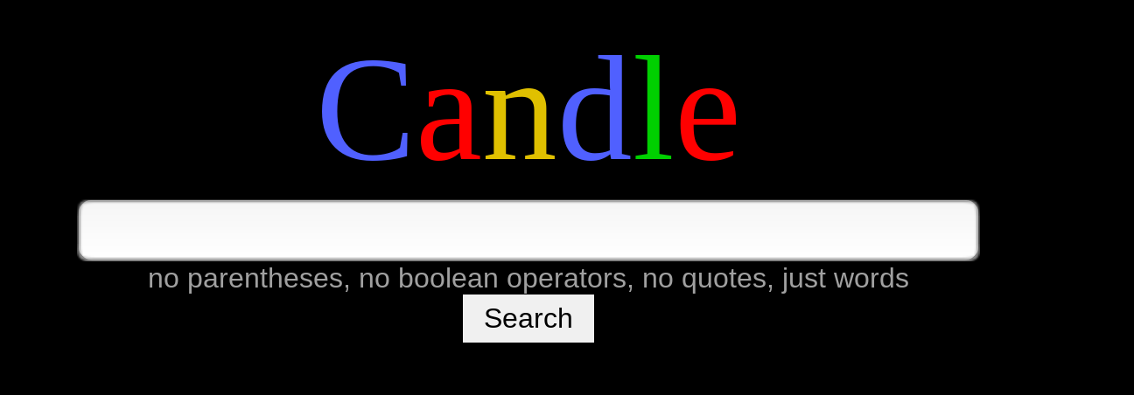
Legitimacy Appropriation

Slide 74

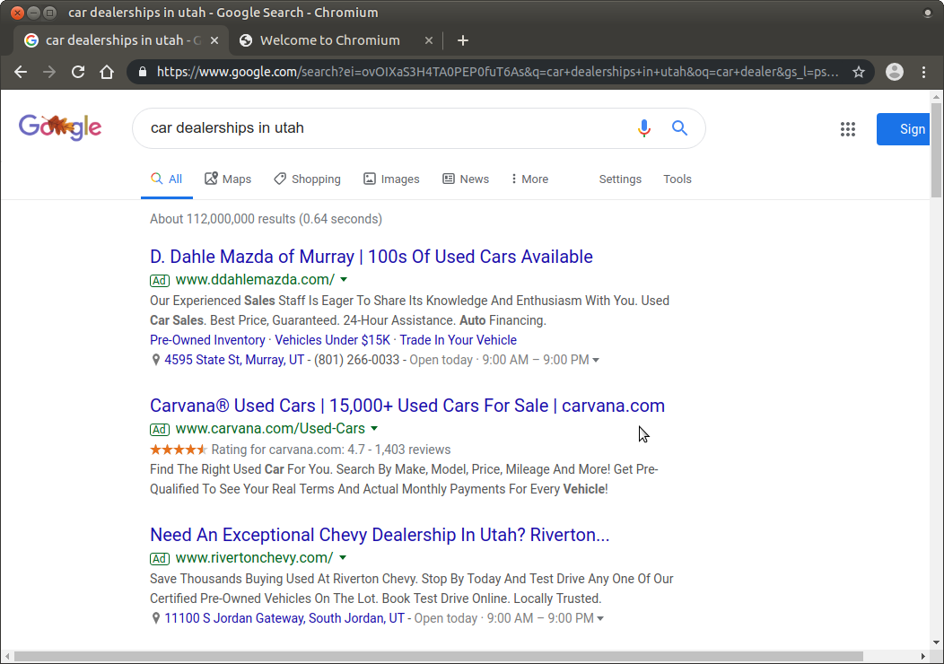
Legitimacy Appropriation

Slide 75

Affecting ‘Clear web’ Practices

Slide 76
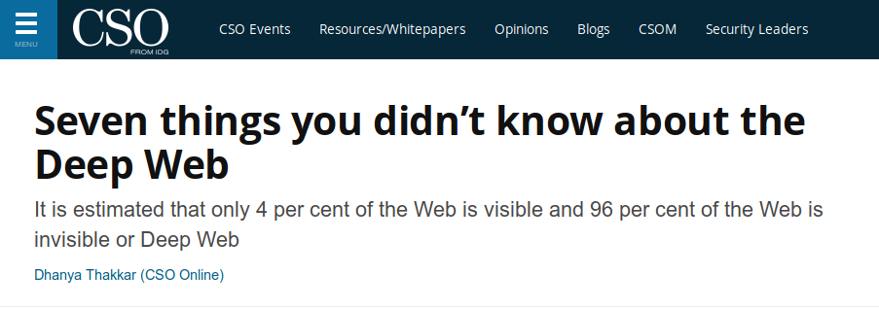
Affecting ‘Clear web’ Practices

Slide 77
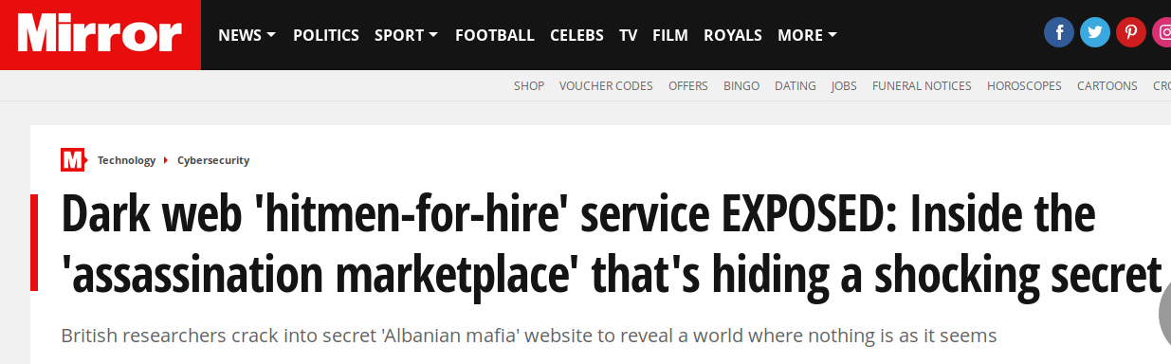
Affecting ‘Clear web’ Practices

Slide 78
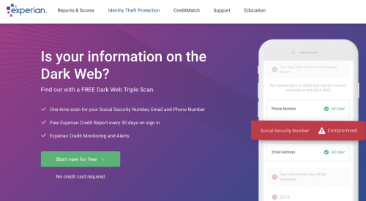
Affecting ‘Clear web’ Practices

Slide 79
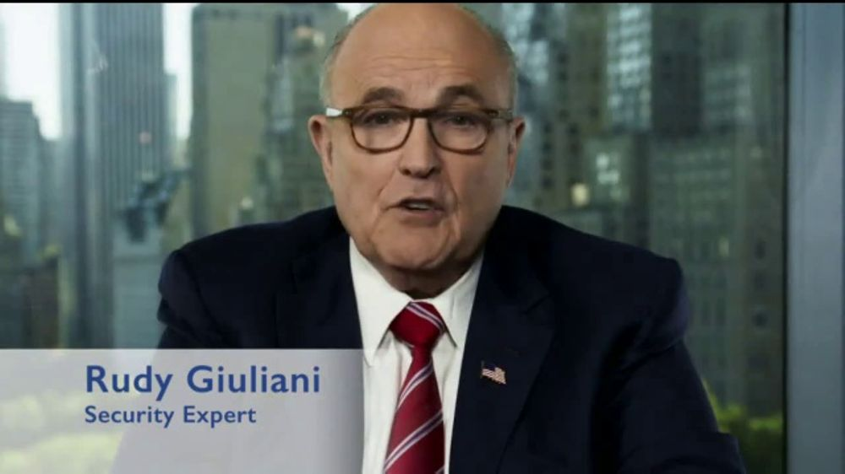
Affecting ‘Clear web’ Practices

Slide 80

Affecting ‘Clear web’ Practices

Slide 81
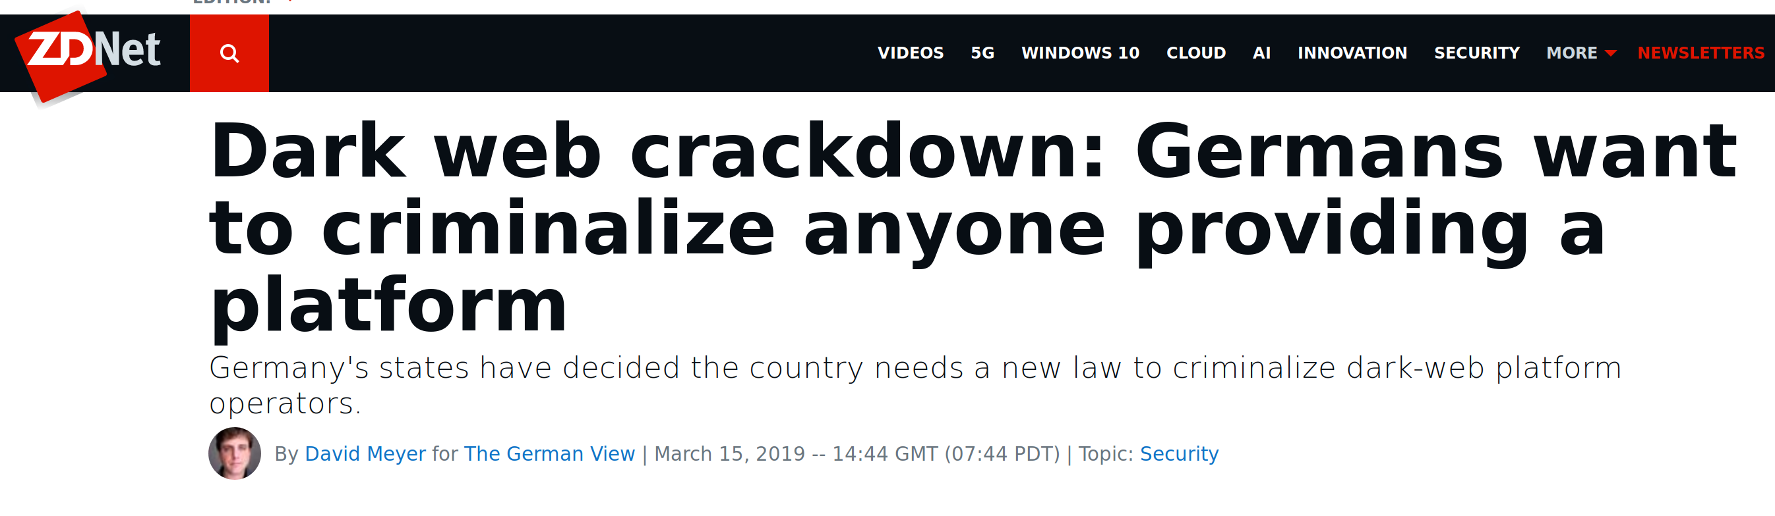
Affecting ‘Clear web’ Practices

Slide 82


There can be no Dark Web Influencer

Slide 83
There can be no Dark Web Influencer

Slide 84
There can be no Dark Web Influencer

Slide 85
There can be no Dark Web Influencer

Slide 86
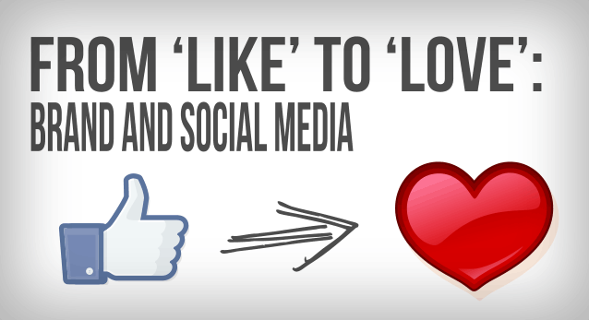
There can be no Dark Web Influencer

Slide 87

There can be no Dark Web Influencer

Slide 88

Gendering of surveillance and privacy

Slide 89
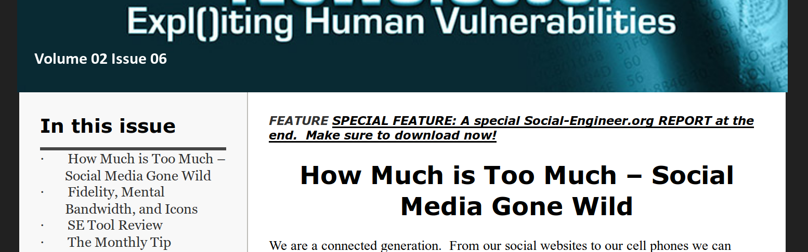
Gendering of surveillance and privacy

Slide 90

Gendering of surveillance and privacy

Slide 91
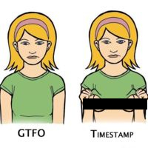
Gendering of surveillance and privacy

Slide 92

Gendering of surveillance and privacy

Slide 93
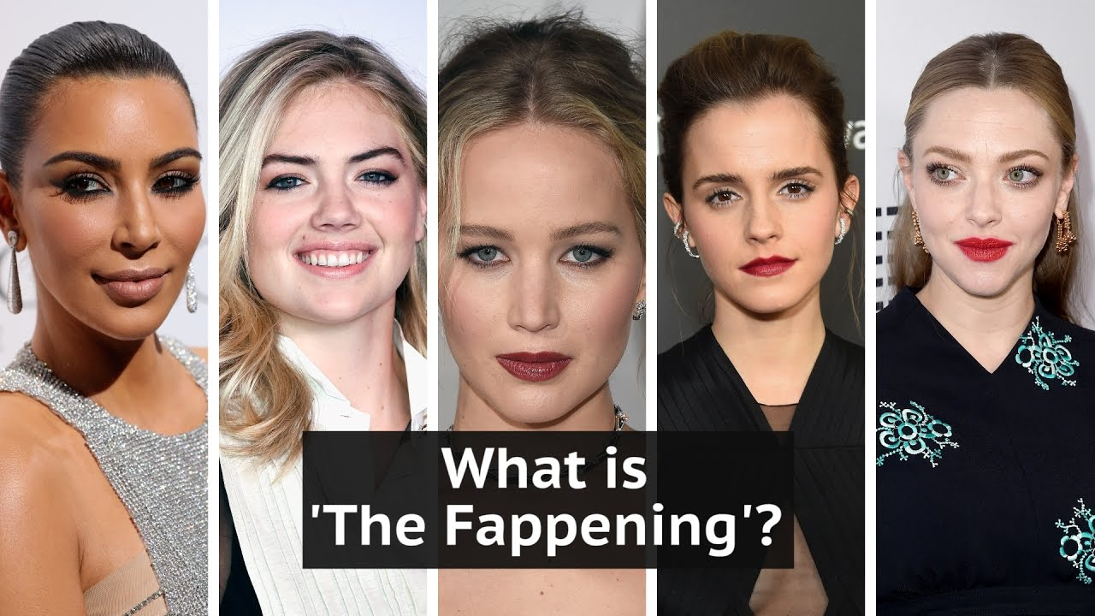
Gendering of surveillance and privacy

Slide 94

Gendering of surveillance and privacy

Slide 95
Truth in Dark Web Advertising
Robert W. Gehl
www.robertwgehl.org
robert@robertwgehl.org

