Slide 1
SEDUCTION ENGINEERING:
THE SHARED HISTORIES OF PICKUP
ARTISTS AND HACKERS
Robert W. Gehl
www.robertwgehl.org
robert@robertwgehl.org

Slide 2

The Faerie Queene

Slide 3
Malengin
“For he so crafty was to forge and face,
So light of hand, and nymble of his pace,
So smooth of tongue, and subtile in his tale.
That could deceiue one looking in his face;
Therefore by name Malengin they him call,
Well knowen by his feates, and famous ouer all.”
- The Faerie Queene, Book 5, Canto IX

Slide 4

hacker Social Engineering...

Slide 5

...And pickup Artistry

Slide 6
Gin and Gens

Slide 7
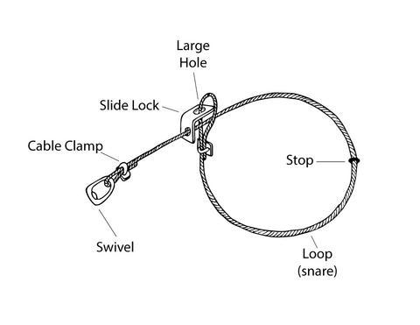
Gin and Gens
Gin: trick or trap, snare or device.
  Also: skill, ingenuity, craft, or artifice

Slide 8

Gin and Gens
Gens: father
  also: a spiritual, procreative capacity of males, progenitory, genesis

Slide 9
Gin and Gens

Slide 10

Gin and Gens
Gin and gens are where “where two modes of misogyny meet… the creative and the procreative.”

Slide 11
Social engineers and Pickup Artists

Slide 12
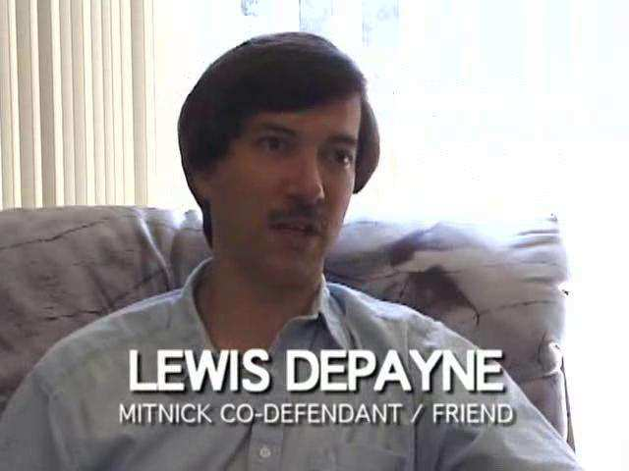
Social engineers and Pickup Artists

Slide 13

Social engineers and Pickup Artists

Slide 14
Social engineers and Pickup Artists
“Sensual Access: The High Tech Guide to Seducing Women Using Your Home Computer.”

Slide 15

Social engineers and Pickup Artists

Slide 16

Social engineers and Pickup Artists

Slide 17
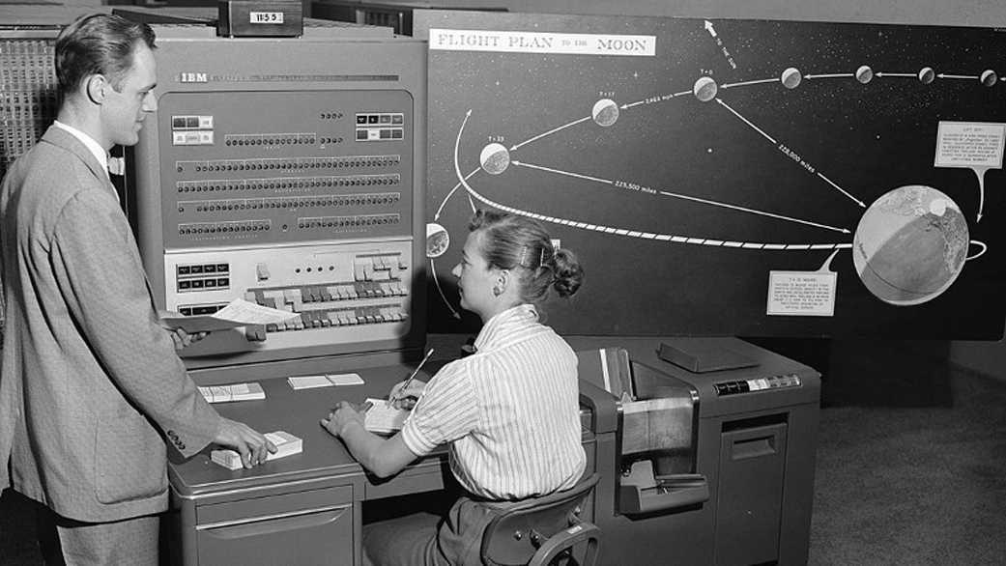
Social engineers and Pickup Artists

Slide 18

Social engineers and Pickup Artists

Slide 19

Social engineers and Pickup Artists

Slide 20
social Engineers and Pickup Artists

Slide 21
distinctions
Social engineers:
  adapt to each scenario
  adapt to each target
  Akin to the “joker” in Michel Serres’ theory of relations

Slide 22
distinctions
Social engineers:
  adapt to each scenario
  adapt to each target
  Akin to the “joker” in Michel Serres’ theory of relations
Pickup artists
  rutheless dedication to one’s inner/outer game
  move on to the next SHB 10/10
  asceticism driving towards being a “Venusian Artist”

Slide 23
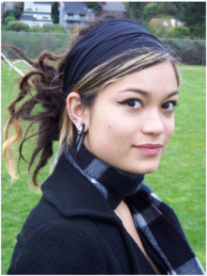
distinctions
Social engineers:
  adapt to each scenario
  adapt to each target
  Akin to the “joker” in Michel Serres’ theory of relations

Slide 24
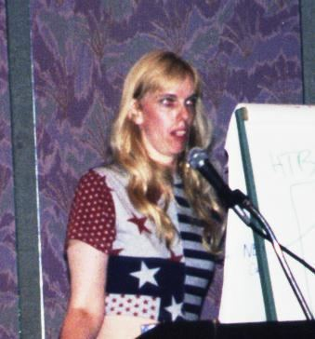
distinctions
Social engineers:
  adapt to each scenario
  adapt to each target
  Akin to the “joker” in Michel Serres’ theory of relations

Slide 25

distinctions
Social engineers:
  adapt to each scenario
  adapt to each target
  Akin to the “joker” in Michel Serres’ theory of relations

Slide 26

distinctions
Social engineers:
  adapt to each scenario
  adapt to each target
  Akin to the “joker” in Michel Serres’ theory of relations

Slide 27
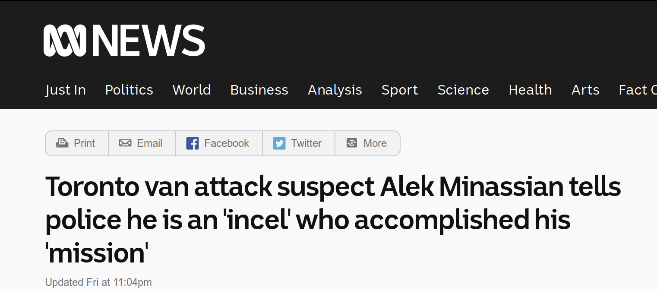
distinctions
Pickup artists
  rutheless dedication to one’s inner/outer game
  move on to the next SHB 10/10
  asceticism driving towards being a “Venusian Artist”

Slide 28
What about Malengin?
“He broke, and did his bowels disentrayle;
Crying in vaine for helpe, when helpe was past.
So did deceipt the selfe deceiuer fayle,
There they him left a carrion outcast;
For beasts and foules to feede vpon for their repast.”
- The Faerie Queene, Book 5, Canto IX

Slide 29
SEDUCTION ENGINEERING:
THE SHARED HISTORIES OF PICKUP
ARTISTS AND HACKERS
Robert W. Gehl
www.robertwgehl.org
robert@robertwgehl.org

